Slide 1
Hypothyroidism & Hyperthyroidism

Slide 2
Introduction
Hyperthyroidism refers to over activity of the thyroid gland, with resultant excessive secretion of thyroid hormones and accelerated metabolism in the periphery
Hypothyroidism is a clinical syndrome resulting from a deficiency of thyroid hormones

Slide 3
Hypothyroidism
There is a generalized slowing down of metabolic processes
In newborn infants – Cretinism
In adolescents – short stature, mental retardation, precocious puberty
In adults – symptoms largely reversible after therapy
Hypothyroidism is seen in both sexes, but is more common in women mostly in the age of 12-50

Slide 4
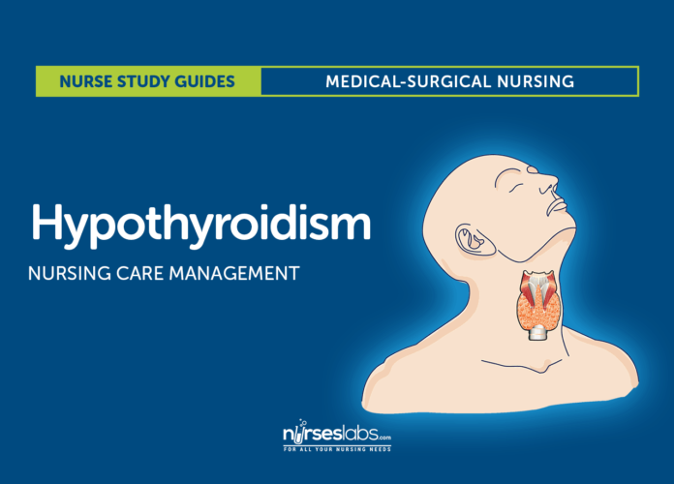

Slide 5
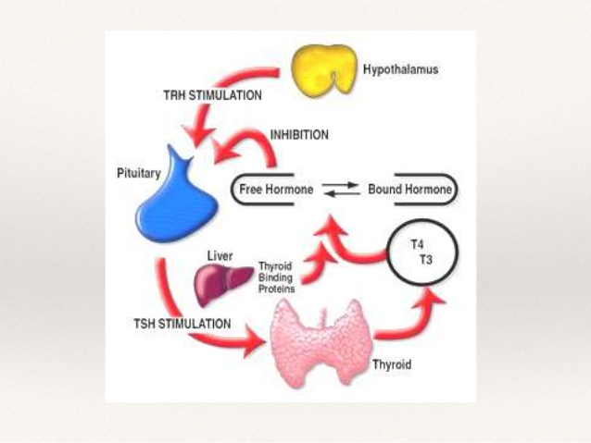

Slide 6
Epidemiology
Neonatal screening reveals incidence that varies between 1-5/1000 live births
The most common cause of preventable mental retardation in children
Both acquired & congenital forms are linked to iodine deficiency
Diagnosis is easy & early treatment is beneficial

Slide 7
Etiology
Acquired
  Iodine deficiency
  Auto-immune thyroiditis
  Thyroidectomy or RAI therapy
  TSH or TRH deficiency
  Medications (iodide & Cobalt)
  Idiopathic

Slide 8
Etiology/2
Congenital
  Hypoplasia & mal-descent
  Familial enzyme defects
  Iodine deficiency (endemic cretinism)
  Intake of goitrogens during pregnancy
  Pituitary defects
  Idiopathic

Slide 9
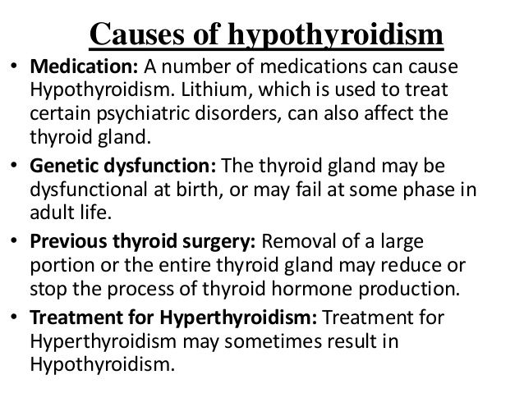
Causes of Hypothyroidism

Slide 10
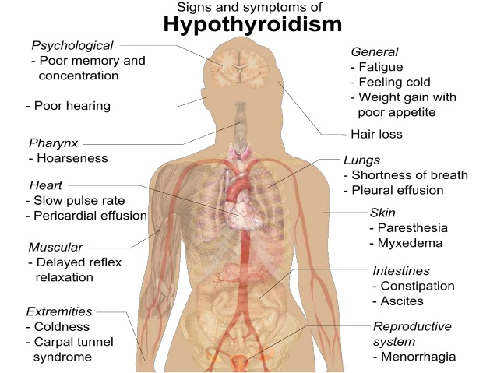
Signs and Symptoms
  Hypothyroidism signs and symptom may include:
  • Fatigue
  • Increased sensitivity to cold
  • Constipation
  • Dry skin
  • Weight gain
  • Puffy face
  • Hoarseness
  • Muscle weakness

Slide 11
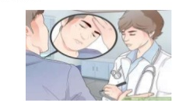
Signs and Symptoms
  Elevated blood cholesterol level
  Muscle aches, tenderness and stiffness
  Pain, stiffness or swelling in your joints
  Heavier than normal or irregular menstrual periods
  Thinning hair
  Slowed heart rate
  Depression
  Impaired memory

Slide 12
Medical Management
Pharmacologic therapy. Synthetic levothyroxine is the preferred preparation for treating hypothyroidism and suppressing nontoxic goiters.
Prevention of cardiac dysfunction. As long as metabolism is subnormal and the tissues require relatively little oxygen, a reduction in the blood supply is tolerated without overt symptoms of coronary artery disease.
Supportive therapy. Oxygen saturation levels should be monitored; fluids should be administered cautiously; application of external heat must be avoided, and oral thyroid hormone therapy should be continued

Slide 13
Nursing Management
Nursing Assessment
  Assessment of the thyroid from an interior or posterior position.
  Auscultation of the lobes of the thyroid gland using the diaphragm of the stethoscope if there are abnormalities palpated.
  Assess thyroid gland for firmness (Hashimoto’s) or tenderness (thyroiditis).
Diagnosis
  Activity intolerance related to fatigue and depressed cognitive process.
  Risk for imbalanced body temperature related to cold intolerance.
  Constipation related to depressed gastrointestinal function.
  Ineffective breathing pattern related to depressed ventilation.
  Disturbed thought processes related to depressed metabolism and altered cardiovascular and respiratory status.

Slide 14
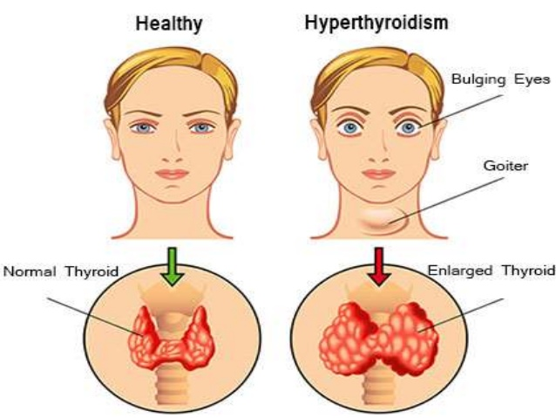
Hyperthyroidism

Slide 15
Epidemiology
Incidence of Women 65.4% and 34.6% in men, 16% of cases occur in patients older than 60 years of age
In Australia, a large number of people suffer from thyroid disorders.

Slide 16
Causes of Hyperthyroidism
Thyroiditis :- inflammation of thyroid gland abnormal stimulation of the thyroid gland by circulation immunoglobulin
The exact case is unknown but recently it though to be associated with thyroid stimulated immunoglobulin
it may appear after and emotional shock stress or an infection

Slide 17
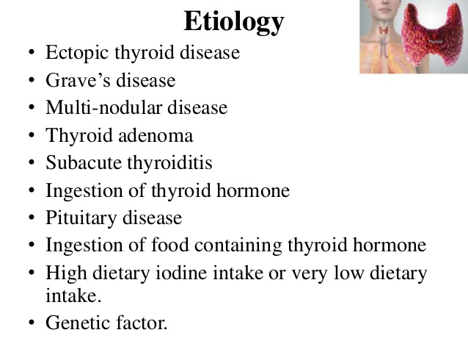
Etiology
Ectopic thyroid disease
Grave’s disease
Multi-nodular disease
Thyroid adenoma
Subacute thyroiditis
Ingestion of thyroid hormone
Pituitary disease
Ingestion of food containing thyroid hormone
High dietary iodine intake or very low dietary intake
Genetic factor

Slide 18
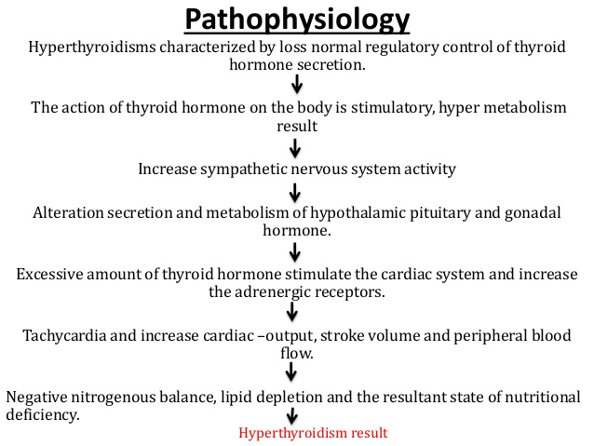

Slide 19
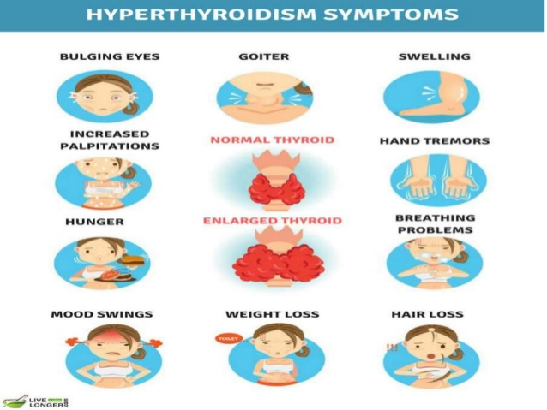
Hyperthyroidism Symptoms

Slide 20
Nursing Management
Imbalanced nutrition less than body requirement related to anorexia and increase metabolic demand is inappropriate. Intervention: - High calorie diet (4000-5000 kcal/day) - High protein diet (1-2 g/kg of ideal body weight) - Frequent meals
Activity intolerance related to exhaustion secondary to accelerated metabolic rate resulting in inability to perform activity without shortness of breath and significant increased in heart rate Intervention: - Assist with regular physical activity. - Assist in activities of daily living - Assist the patient to schedule rest periods

Slide 21
Effects of Hypothyroidism & Hyperthyroidism

Slide 22
References
Baltaci, A. K., & Mogulkoc, R. (2017). Leptin, NPY, melatonin and zinc levels in experimental hypothyroidism and hyperthyroidism: the relation to zinc. Biochemical genetics, 55(3), 223-233.
Bargi-Souza, P., Peliciari-Garcia, R. A., & Nunes, M. T. (2019). Disruption of the Pituitary Circadian Clock Induced by Hypothyroidism and Hyperthyroidism: Consequences on Daily Pituitary Hormone Expression Profiles. Thyroid, 29(4), 502-512.
Kopecny, L., Higgs, P., Hibbert, A., Malik, R., & Harvey, A. M. (2017). Management and monitoring of hyperthyroid cats: a survey of Australian veterinarians. Journal of feline medicine and surgery, 19(6), 559-567.

Slide 23
References
Pearce, E. N. (2015). Thyroid disorders during pregnancy and postpartum. Best Practice & Research Clinical Obstetrics & Gynaecology, 29(5), 700-706.
Taylor, P. N., Albrecht, D., Scholz, A., Gutierrez-Buey, G., Lazarus, J. H., Dayan, C. M., & Okosieme, O. E. (2018). Global epidemiology of hyperthyroidism and hypothyroidism. Nature Reviews Endocrinology, 14(5), 301.
Yao, M., Dooley, P. C., Schuijers, J. A., & Grills, B. L. (2004). The effects of hypothyroidism on nerve growth factor and norepinephrine concentrations in weight-bearing and non-weight-bearing bones of rats. Journal of Musculoskeletal and Neuronal Interactions, 4(3), 319

